Slide 1

Time Series Analysis
Exploratory Data Analysis

Slide 2
Using Line and Box Plots to Visualize Time Series Data
Lesson 1

Slide 3
Objective
Learn how to explore and visualize time series data using line plots and box plots, which reveal trends, seasonality, and distribution across time.

Slide 4
Time Series Data
Data collected at regular time intervals (daily, monthly, yearly, etc.).
Common examples: stock prices, weather data, sales over time, website traffic, etc.
Each observation is indexed by a date or timestamp.

Slide 5
Line Plots
Show how a variable changes over time.
Best suited for identifying overall trends, seasonal patterns, and anomalies.
A continuous visual — ideal for temporal continuity.

Slide 6
Box Plots for Time Series
Summarize data distribution across time-based categories (e.g., months, days of week, years).
Highlight outliers, median, spread, and seasonal variance.
Useful for understanding periodic fluctuations (like sales peaking in December).

Slide 7
EDA Objective
Identify overall movement of the data.
Detect irregularities, missing data, or unexpected spikes.
Discover seasonal patterns or cycles visually.

Slide 8
Code

Slide 9
# Import libraries
import pandas as pd
import numpy as np

Slide 10
# Generate date range
date_rng = pd.date_range(
start='2018-01-01’,
end='2023-12-31’,
freq='M’
)

Slide 11
# Simulate sales data with seasonality and noise
np.random.seed(42)
sales = 200 +
20 * np.sin(2 * np.pi * date_rng.month / 12) +
np.random.normal(0, 5, len(date_rng))

Slide 12
# Create DataFrame
df = pd.DataFrame(
{
'Date': date_rng,
'Sales': sales
}
)
df.set_index('Date', inplace=True)

Slide 13
Step 1: Line Plot using Matplotlib and Seaborn

Slide 14
import matplotlib.pyplot as plt
import seaborn as sns
plt.figure(figsize=(12, 6))
sns.lineplot(x=df.index, y=df['Sales'])
plt.title('Monthly Sales Over Time (2018–2023)', fontsize=14)
plt.xlabel('Date')
plt.ylabel('Sales ($)')
plt.grid(True)
plt.show()

Slide 15
Interpretation
The wavy pattern suggests seasonality (periodic fluctuation).
The slight upward or downward trend may indicate growth or decline.
Sudden dips or spikes might indicate promotions, holidays, or external events.

Slide 16
Step 2: Box Plot by Month

Slide 17
# We extract the month and visualize sales distribution per month
df['Month'] = df.index.month
plt.figure(figsize=(10, 6))
sns.boxplot(x='Month', y='Sales', data=df)
plt.show()

Slide 18
Interpretation
Helps identify which months consistently perform higher.
Detects months with high variance (volatile sales).
Outliers (dots) might correspond to unusual events (e.g., festive surge).

Slide 19
Step 3: Box Plot by Year

Slide 20
# Visualize inter-annual changes
df['Year'] = df.index.year
plt.figure(figsize=(10, 6))
sns.boxplot(x='Year', y='Sales', data=df)
plt.title(
'Yearly Sales Distribution (2018–2023)’,
fontsize=14
)
plt.xlabel('Year')
plt.ylabel('Sales ($)')
plt.show()

Slide 21
Interpretation
Year-to-year variation indicates whether business performance improves or worsens.
Gradual upward shift = growth trend.
Wider boxes = more unstable or volatile performance.

Slide 22
Step 4: Combined Insights
Plot Type | Reveals | Example Insight
Line Plot | Trend + seasonality | "Sales peak mid-year and drop at year-end"
Monthly Box Plot | Seasonal strength | "July consistently has highest sales"
Yearly Box Plot | Long-term trend | "Median sales increased steadily since 2019"

Slide 23
Best Practices
Always index by DateTime for pandas operations.
Combine line plots with rolling averages for smoother trends.
For multivariate time series, use facet grids or multiple lines for comparison.
Adjust frequency (daily, weekly, monthly) based on data granularity.

Slide 24
Practical Exercise
Try modifying:
The frequency to 'D' (daily) or 'W' (weekly) and re-run the plots.
Add another variable (e.g., Cost or Profit) and visualize multiple time series on one plot.

Slide 25
Spotting Patterns in Time Series
Lesson 2

Slide 26
Objective
Learn how to identify patterns in time series data — such as trend, seasonality, cyclic behavior, and irregular (random) variations — using visual and statistical tools in pandas, matplotlib, and seaborn.

Slide 27
Conceptual Explanation
A time series is more than just numbers over time — it has structure. Spotting these patterns is the first step before any advanced time series analysis or forecasting.

Slide 28
1. Trend
The long-term direction of the data (increasing, decreasing, or flat).
Can be linear or nonlinear.
Example: Increasing global temperatures over decades.

Slide 29
2. Seasonality
Regular and repeating patterns that occur at fixed intervals (e.g., monthly, yearly).
Example: Ice cream sales peak every summer.

Slide 30
3. Cyclic Behavior
Repeating patterns without fixed intervals (longer-term economic or natural cycles).
Example: Recession cycles or rainfall variability.

Slide 31
4. Irregular / Random Component
Unpredictable variations due to random noise, unusual events, or measurement errors.
Example: Sudden spike due to a one-time promotion.

Slide 32
Dataset
We’ll reuse and slightly extend the monthly sales dataset from Lesson 1, but add an upward trend and more seasonality to make patterns clearer.

Slide 33
# Import libraries
import pandas as pd
import numpy as np

Slide 34
# Create time index
date_rng = pd.date_range(
start='2015-01-01’,
end='2023-12-31’,
freq='M’
)

Slide 35
# Simulate trend + seasonality + noise
np.random.seed(42)
# upward trend
trend = np.linspace(100, 300, len(date_rng))
# yearly seasonality
seasonality = 30 * np.sin(2 * np.pi * date_rng.month / 12)
# random noise
noise = np.random.normal(0, 8, len(date_rng))
sales = trend + seasonality + noise

Slide 36
# Create DataFrame
df = pd.DataFrame(
{
'Date': date_rng,
'Sales': sales
}
)
df.set_index('Date', inplace=True)

Slide 37
Step 1: Visualize the Time Series

Slide 38
import matplotlib.pyplot as plt
import seaborn as sns
plt.figure(figsize=(12, 6))
sns.lineplot(x=df.index, y=df['Sales'])
plt.grid(True)
plt.show()

Slide 39
Interpretation
You can clearly see a gradual upward movement (trend).
Repeating up-and-down wave (seasonality) each year.
Minor random fluctuations — noise or irregularities.

Slide 40
Step 2: Highlighting the Trend

Slide 41
# To isolate the trend visually, apply a rolling mean (moving average).
df['RollingMean'] = df['Sales'].rolling(window=12, center=True).mean()

Slide 42
sns.lineplot(
x=df.index, y='Sales’,
data=df, label='Original’
)
sns.lineplot(
x=df.index, y='RollingMean’,
data=df, label='12-Month Rolling Mean’,
color='red’
)
plt.title('Trend Identification with Rolling Mean')
plt.show()

Slide 43
Interpretation
The red line smooths short-term fluctuations, revealing a long-term upward trend.
Useful for removing seasonality and noise visually.

Slide 44
Step 3: Identifying Seasonality by Month

Slide 45
# Group and average the data by month to see seasonal patterns
df['Month'] = df.index.month
monthly_avg = df.groupby('Month')['Sales'].mean()

Slide 46
plt.figure(figsize=(10, 5))
sns.lineplot(
x=monthly_avg.index,
y=monthly_avg.values,
marker='o’
)
plt.show()

Slide 47
Interpretation
Peaks and troughs correspond to months with high or low sales.
Indicates repeating annual seasonality.

Slide 48
Step 4: Detecting Cyclic Behavior

Slide 49
# Cyclic patterns are longer-term fluctuations not bound to fixed intervals (like business cycles).
# We can visualize multi-year average patterns:
df['Year'] = df.index.year
yearly_avg = df.groupby('Year')['Sales'].mean()

Slide 50
plt.figure(figsize=(10, 5))
sns.lineplot(
x=yearly_avg.index,
y=yearly_avg.values,
marker='o’
)
plt.show()

Slide 51
Interpretation
If the line shows long-term up and down swings beyond yearly repetition, it suggests cyclicity.
Example: "Sales growth slowed in 2020–2021, possibly due to external factors."

Slide 52
Step 5: Spotting Random or Irregular Variations

Slide 53
# We can isolate the random component by removing the smoothed trend
df['Detrended'] = df['Sales'] - df['RollingMean']
sns.lineplot(
x=df.index,
y='Detrended’,
data=df
)
plt.axhline(0, color='red', linestyle='--')
plt.show()

Slide 54
Interpretation
Fluctuations around zero show random variation after removing trend and seasonality.
Helps identify unusual spikes or data quality issues.

Slide 55
Summary Table of Patterns
Pattern | Description | Detection Method | Visual Indicator
Trend | Long-term movement | Rolling mean, regression | Upward or downward slope
Seasonality | Fixed repeating cycle | Group by month/week | Regular oscillations
Cyclic | Long-term irregular oscillations | Group by year | Multi-year waves
Irregular | Random noise | Detrended data | Random spikes

Slide 56
Practical Exercise
Modify the simulation to include a downward trend and see how line plots differ.
Add a second variable (e.g., “Expenses”) and compare its pattern to “Sales.”

Slide 57
Performing Time Series Data Decomposition
Lesson 3

Slide 58
Objective
To decompose a time series into its fundamental components — trend, seasonality, and residual (noise) — so we can understand how each part contributes to the behavior of the whole series.

Slide 59
Conceptual Explanation
Decomposition helps reveal hidden structures within a time series by breaking it down mathematically and visually.

Slide 60
The Three Core Components
Trend (T):
The long-term progression or general direction of the data.
Captures whether the series is increasing, decreasing, or stable over time.
Seasonal (S):
Periodic, repeating fluctuations at fixed intervals (e.g., monthly, yearly).
Reflects patterns that repeat regularly.
Residual (R):
The remainder after removing trend and seasonality.
Represents randomness, irregularities, or noise.

Slide 61
Two Types of Decomposition Models
Additive Model:
Yt = Tt + St + Rt​
Use when seasonal variation is roughly constant through time.
Example: Temperature data, where amplitude is steady.
Multiplicative Model:
Yt = Tt × St × Rt​
Use when seasonal variation grows or shrinks proportionally with the trend.
Example: Retail sales with larger fluctuations as sales volume increases.

Slide 62
Dataset
We’ll reuse the monthly retail sales data from Lessons 1–2, and apply decomposition.

Slide 63
# Create a time index
date_rng = pd.date_range(
start='2015-01-01’,
end='2023-12-31’,
freq='M’
)

Slide 64
# Simulate upward trend + strong seasonality + noise
np.random.seed(42)
trend = np.linspace(100, 300, len(date_rng))
seasonality = 25 *
np.sin(2 * np.pi * date_rng.month / 12)
noise = np.random.normal(
0, 8, len(date_rng)
)
sales = trend + seasonality + noise

Slide 65
df = pd.DataFrame(
{
'Date': date_rng,
'Sales': sales
}
)
df.set_index('Date', inplace=True)

Slide 66
Step 1: Import Decomposition Tool
We’ll use the seasonal_decompose function from statsmodels, which supports both additive and multiplicative models.

Slide 67
# Imports
from statsmodels.tsa.seasonal import seasonal_decompose
import matplotlib.pyplot as plt

Slide 68
# Perform additive decomposition
decomposition = seasonal_decompose(
df['Sales’],
model='additive’,
period=12
)

Slide 69
# Plot the decomposition results
plt.rcParams.update(
{'figure.figsize': (12, 9)}
)
decomposition.plot()
plt.suptitle(
'Additive Decomposition of Monthly Sales’,
fontsize=14
)

Slide 70
Step 2: Interpret the Components
The output shows four panels:
Observed (Top Panel) — Original time series.
The raw data showing all fluctuations together.
Trend — The smooth long-term direction.
Usually extracted using a moving average filter.
Seasonal — The repetitive pattern within a year.
Repeats every “period” (12 months in this case).
Residual (Random) — The remaining noise after removing trend & seasonality.
Should appear random (white noise).

Slide 71
Additive vs. Multiplicative Example

Slide 72
# Multiplicative decomposition
decomposition_mul = seasonal_decompose(
df['Sales’],
model='multiplicative’,
period=12
)

Slide 73
plt.rcParams.update(
{'figure.figsize': (12, 9)}
)
decomposition_mul.plot()
plt.suptitle(
'Multiplicative Decomposition of Monthly Sales’,
fontsize=14
)

Slide 74
When to Use Each
Model Type | When to Use | Equation | Example
Additive | Constant seasonal impact | (Y_t = T_t + S_t + R_t) | Temperature, traffic volume
Multiplicative | Seasonality changes with level | (Y_t = T_t \times S_t \times R_t) | Sales, population growth

Slide 75
Step 3: Inspect Each Component
You can extract and examine each component individually.

Slide 76
df['Trend'] = decomposition.trend
df['Seasonal'] = decomposition.seasonal
df['Residual'] = decomposition.resid
df[['Sales', 'Trend', 'Seasonal', 'Residual']].head(15)

Slide 77
# Now visualize the trend separately:
plt.figure(figsize=(12,5))
plt.plot(df['Trend'], color='red')

Slide 78
Step 4: Seasonal Component Visualization
This shows how the pattern repeats every year.

Slide 79
df['Month'] = df.index.month
seasonal_pattern = df.groupby('Month')['Seasonal'].mean()
plt.figure(figsize=(10,5))
plt.plot(seasonal_pattern.index, seasonal_pattern.values, marker='o')

Slide 80
Interpretation
Positive values = months above the trend (sales boost).
Negative values = months below the trend (slump).
Reveals seasonal high and low months.

Slide 81
Step 5: Residual Component
plt.figure(figsize=(12,5))
plt.plot(df['Residual'], color='gray')
plt.axhline(0, color='red', linestyle='--')

Slide 82
Interpretation
If the residuals appear random (no clear trend), the decomposition is good.
If patterns remain, it may indicate model misfit or missing variables.

Slide 83
Practical Insights
Insight | What You Learn
Trend | Long-term business growth or decline
Seasonality | Repeating sales cycles (e.g., festive periods)
Residual | Random external shocks, outliers, or errors

Slide 84
Common Pitfalls
Incorrect frequency (period) → Always specify period=12 for monthly or period=7 for weekly data.
Missing values → Must be handled before decomposition.
Short data range → At least 2–3 complete seasonal cycles are required.
Multiplicative misuse → Avoid multiplicative if data contains zeros or negatives.

Slide 85
Performing Smoothing — Moving Average
Lesson 4

Slide 86
Objective
To learn how to reduce short-term fluctuations and highlight long-term trends in a time series using moving average smoothing in pandas and visualize the effects with matplotlib and seaborn.

Slide 87
Conceptual Explanation

Slide 88
1. What is Smoothing?
Smoothing removes random noise from a time series to make patterns clearer.
It’s used in exploratory analysis to:
Reveal underlying trends.
Make seasonal cycles easier to see.
Prepare data for decomposition or forecasting.

Slide 89
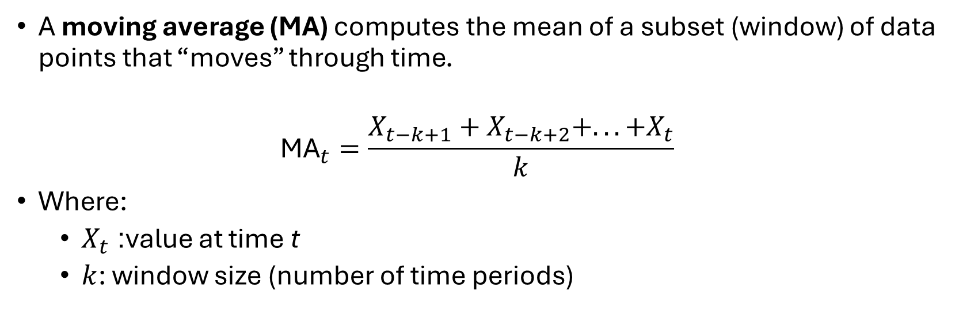
2. What is a Moving Average?
A moving average (MA) computes the mean of a subset (window) of data points that “moves” through time.
$${\text{MA}}_{t}=\frac{X_{t−k+1}+X_{t−k+2}+...+X_{t}}{k}$$
Where:
$X_{t}$: value at time t
$k$: window size (number of time periods)

Slide 90
3. Why Moving Average Works
It filters out random noise.
It smooths volatility, especially in short-term data.
Longer windows produce smoother curves (but slower response to change).

Slide 91
4. Common Types of Moving Averages
Type | Description | Use Case
Simple Moving Average (SMA) | Mean of last k values | General smoothing
Weighted Moving Average (WMA) | Assigns weights (recent points get higher weight) | Emphasize recent trends
Exponential Moving Average (EMA) | Recent values exponentially more important | Quick trend detection (next lesson)

Slide 92
Dataset
We’ll reuse the monthly sales dataset (2015–2023) used in the previous lessons, which contains clear trend, seasonality, and noise.

Slide 93
Step 1: Plot the Original Series

Slide 94
sns.lineplot(x=df.index, y='Sales', data=df)

Slide 95
Observation: You’ll see an upward trend with visible seasonal fluctuations and random noise.

Slide 96
Step 2: Apply a Simple Moving Average (SMA)

Slide 97
# Let’s apply a 12-month rolling window (1-year smoothing).
df['SMA_12'] = df['Sales'].rolling(window=12).mean()

Slide 98
sns.lineplot(x=df.index, y='Sales', data=df,
label='Original', alpha=0.6)
sns.lineplot(x=df.index, y='SMA_12', data=df,
label='12-Month SMA', color='red')

Slide 99
Interpretation
The red line (SMA) smooths the original fluctuations.
The general upward trend is now clearer.
Seasonal peaks are flattened — this reveals long-term progression.

Slide 100
Step 3: Compare Different Window Sizes

Slide 101
# Let’s see how the choice of window affects the smoothness.
df['SMA_3'] = df['Sales'].rolling(window=3).mean()
df['SMA_6'] = df['Sales'].rolling(window=6).mean()
df['SMA_12'] = df['Sales'].rolling(window=12).mean()

Slide 102
sns.lineplot(x=df.index, y='Sales', data=df,
label='Original', alpha=0.4)
sns.lineplot(x=df.index, y='SMA_3', data=df,
label='3-Month SMA’)
sns.lineplot(x=df.index, y='SMA_6', data=df,
label='6-Month SMA’)
sns.lineplot(x=df.index, y='SMA_12', data=df,
label='12-Month SMA')

Slide 103
Interpretation
Window | Behavior | When to Use
3-Month | Sensitive, quick to respond | Short-term patterns
6-Month | Balanced smoothing | Medium-term analysis
12-Month | Very smooth | Long-term trend analysis

Slide 104
Step 4: Centered Moving Average
By default, moving averages are trailing (they lag behind actual data). To align them symmetrically, use centered=True.

Slide 105
df['SMA_centered'] = df['Sales'].rolling(window=12, center=True).mean()
sns.lineplot(x=df.index, y='Sales', data=df,
label='Original', alpha=0.4)
sns.lineplot(x=df.index, y='SMA_centered’,
data=df, label='Centered 12-Month SMA’,
color='red')

Slide 106
Interpretation
The centered SMA aligns better with the true trend.
Trailing averages lag — useful for forecasting visualization, not direct interpretation.

Slide 107
Step 5: Residuals After Smoothing
We can calculate residuals (the difference between actual and smoothed values) to analyze irregular components.

Slide 108
df['Residuals'] = df['Sales'] - df['SMA_12']
sns.lineplot(x=df.index, y='Residuals’,
data=df, color='gray')
plt.axhline(0, color='red', linestyle='--')

Slide 109
Interpretation
Residuals oscillate around zero.
Large spikes or dips may indicate unusual events or outliers.
Useful for detecting irregular or non-seasonal influences.

Slide 110
Step 6: Rolling Statistics in Pandas
Pandas offers built-in rolling operations for mean, std, min, max, etc.

Slide 111
rolling_stats = (
df['Sales'].rolling(window=12)
.agg(['mean', 'std’])
)
rolling_stats.head(15)

Slide 112
This helps measure stability (stationarity) — when mean and variance remain constant over time.

Slide 113
Practical Insights
Use Case | Technique
Trend detection | 12-month moving average
Noise reduction | 3–6 month rolling window
Business cycles | 24-month rolling window
Aligning trends with events | Centered moving average
Identifying anomalies | Compare residuals vs. smoothed trend

Slide 114

Common Pitfalls
Window
Window too small → Overreacts to noise.
Window
Window too large → Over-smooths, hides meaningful changes.
Edge
Edge effects → Missing values at beginning/end due to insufficient data.
Don’t use
Misinterpretation → SMA removes information; don’t use for precise forecasting.

Slide 115
Performing Smoothing — Exponential Smoothing
Lesson 5

Slide 116
Objective
To understand and apply Exponential Smoothing (ES) for time series analysis using pandas and statsmodels, and visualize how it provides a responsive yet smooth trend line compared to simple moving averages.

Slide 117
Conceptual Explanation

Slide 118
1. What is Exponential Smoothing?
Exponential Smoothing is a method of weighted averaging where recent observations are given more importance (higher weights) than older ones.
Unlike the Simple Moving Average (SMA), which assigns equal weights to all data points in the window, exponential smoothing decays weights exponentially as observations get older.

Slide 119
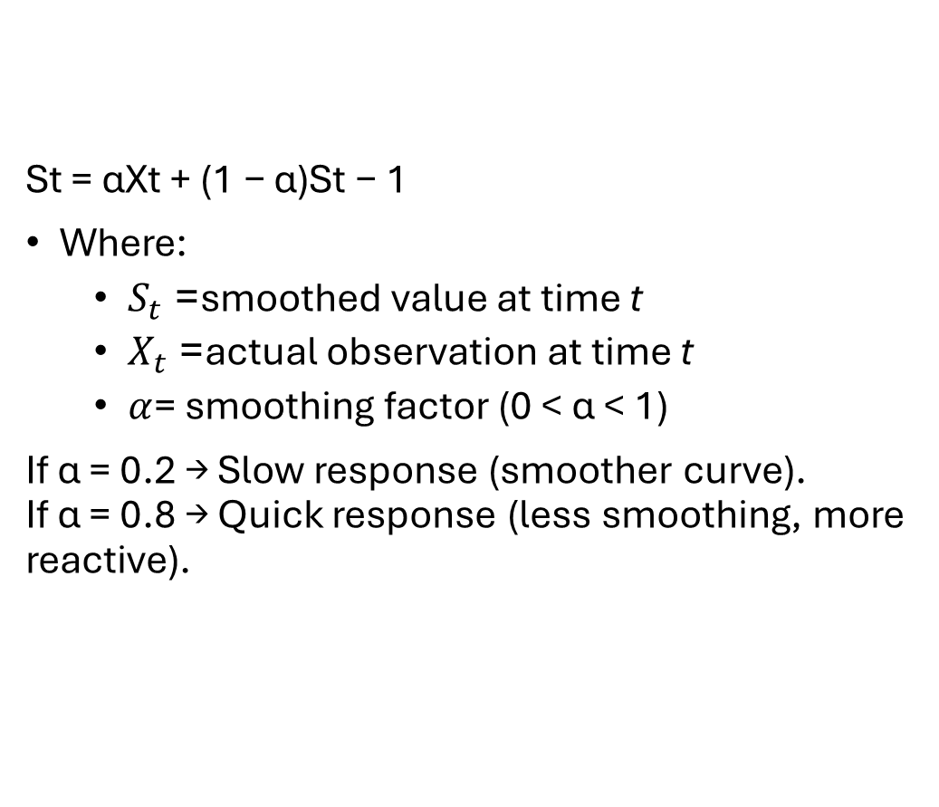
2. The Core Formula
St​ = αXt ​+ (1 − α)St − 1​
Where:
$S_{t}$= smoothed value at time t
$X_{t}$= actual observation at time t
$α$= smoothing factor (0 < α < 1)
If α = 0.2 → Slow response (smoother curve). If α = 0.8 → Quick response (less smoothing, more reactive).

Slide 120
3. Why It’s Important
Concept | SMA | Exponential Smoothing
Weight distribution | Equal | Exponentially decreasing
Sensitivity | Slow | Adjustable via α
Lag effect | Larger | Smaller
Adaptability | Static | Adaptive to new changes

Slide 121
This makes exponential smoothing ideal for trend detection in data that evolves quickly — e.g., sales, temperature, or website traffic.

Slide 122
Dataset
We’ll reuse the monthly retail sales data (2015–2023) with trend and seasonality for consistency.

Slide 123
# Create time index
date_rng = pd.date_range(
start='2015-01-01’,
end='2023-12-31’,
freq='M’
)

Slide 124
# Generate synthetic sales data
np.random.seed(42)
trend = np.linspace(100, 300, len(date_rng))
seasonality = 20 * \
np.sin(2 * np.pi * date_rng.month / 12)
noise = np.random.normal(0, 8, len(date_rng))
sales = trend + seasonality + noise

Slide 125
df = pd.DataFrame(
{
'Date': date_rng,
'Sales': sales
}
)
df.set_index('Date', inplace=True)

Slide 126
Step 1: Visualize the Original Series

Slide 127
sns.lineplot(x=df.index, y='Sales', data=df)
You’ll notice upward movement, seasonal waves, and random noise — the same pattern we’ll now smooth.

Slide 128
Step 2: Apply Exponential Smoothing (Single Smoothing)
Pandas provides a built-in exponential weighted moving average (EWMA) via .ewm().

Slide 129
# Apply exponential smoothing with alpha = 0.3
df['ES_0.3'] = (
df['Sales’]
.ewm(alpha=0.3, adjust=False)
.mean()
)

Slide 130
sns.lineplot(
x=df.index, y='Sales', data=df,
label='Original', alpha=0.5
)
sns.lineplot(
x=df.index, y='ES_0.3', data=df,
label='Exponential Smoothing (α=0.3)’,
color='red’
)
plt.show()

Slide 131
Interpretation
Red line follows the trend more smoothly than the raw data.
Recent points have more influence, making it responsive but stable.

Slide 132
Step 3: Compare Different α Values
The smoothing factor α controls how responsive the model is to changes.

Slide 133
df['ES_0.1'] = df['Sales'].ewm(alpha=0.1, adjust=False).mean()
df['ES_0.5'] = df['Sales'].ewm(alpha=0.5, adjust=False).mean()
df['ES_0.8'] = df['Sales'].ewm(alpha=0.8, adjust=False).mean()

Slide 134
sns.lineplot(x=df.index, y='Sales', data=df, label='Original', alpha=0.4)
sns.lineplot(x=df.index, y='ES_0.1', data=df, label='α=0.1’)
sns.lineplot(x=df.index, y='ES_0.5', data=df, label='α=0.5’)
sns.lineplot(x=df.index, y='ES_0.8', data=df, label='α=0.8')

Slide 135
Interpretation
α Value | Behavior | Description
0.1 | Very smooth | Slow to react, ignores short-term spikes
0.3 | Balanced | Good for medium-term trend
0.5 | More responsive | Reacts faster to recent changes
0.8 | Highly sensitive | Follows data closely (less smoothing)

Slide 136
Step 4: Using Statsmodels — Simple Exponential Smoothing
You can also use the SimpleExpSmoothing class from statsmodels.tsa.holtwinters for more control.

Slide 137
from statsmodels.tsa.holtwinters import SimpleExpSmoothing
model = SimpleExpSmoothing(df['Sales'])
fit = model.fit(smoothing_level=0.3, optimized=False)
df['SES_0.3'] = fit.fittedvalues

Slide 138
sns.lineplot(x=df.index, y='Sales', data=df, label='Original', alpha=0.5)
sns.lineplot(x=df.index, y='SES_0.3', data=df, label='Simple Exp Smoothing (α=0.3)', color='red’)
plt.show()

Slide 139
The results match .ewm() but are easier to extend later (e.g., to double or triple exponential smoothing).

Slide 140
Step 5: Compare Exponential vs. Simple Moving Average
Let’s visualize both on the same plot to understand differences.

Slide 141
df['SMA_12'] = df['Sales'].rolling(window=12).mean()
sns.lineplot(x=df.index, y='Sales', data=df, label='Original', alpha=0.4)
sns.lineplot(x=df.index, y='SMA_12', data=df, label='12-Month SMA’)
sns.lineplot(x=df.index, y='ES_0.3', data=df, label='Exp Smoothing (α=0.3)', color='red')
plt.show()

Slide 142
Key Difference
SMA lags more and reacts slowly to new changes.
Exponential Smoothing adapts faster while retaining stability.

Slide 143
Step 6: Extracting and Analyzing Residuals
We can analyze deviations between actual and smoothed values to understand volatility.

Slide 144
df['Residuals'] = df['Sales'] - df['ES_0.3']
sns.lineplot(
x=df.index, y='Residuals’,
data=df, color='gray’
)
plt.axhline(0, color='red', linestyle='--’)
plt.show()

Slide 145
Residuals that are mostly random (white noise) suggest a good smoothing fit.

Slide 146
Practical Use Cases
Scenario | Method | α Value Suggestion
Stable, slow-changing data | Exponential Smoothing | α = 0.1–0.3
Volatile or fast-changing data | Exponential Smoothing | α = 0.5–0.8
Daily stock data | EWMA | α = 0.6–0.9
Monthly business trends | EWMA | α = 0.2–0.4

Slide 147
Common Pitfalls
Choosing α blindly — Always test several α values for balance between responsiveness and smoothness.
Confusing smoothing with forecasting — Exponential smoothing reveals patterns; it doesn’t predict future values (unless extended to Holt-Winters).
Not handling missing values — NaNs can distort results; use fillna() first.
Over-smoothing — Too small α hides meaningful short-term variations.

Slide 148
Performing Stationarity Checks on Time Series Data
Lesson 6

Slide 149
Objective
To understand the concept of stationarity in time series data, why it matters, and how to test for it using both visual and statistical methods (rolling statistics and the Augmented Dickey–Fuller test).

Slide 150
Conceptual Explanation

Slide 151
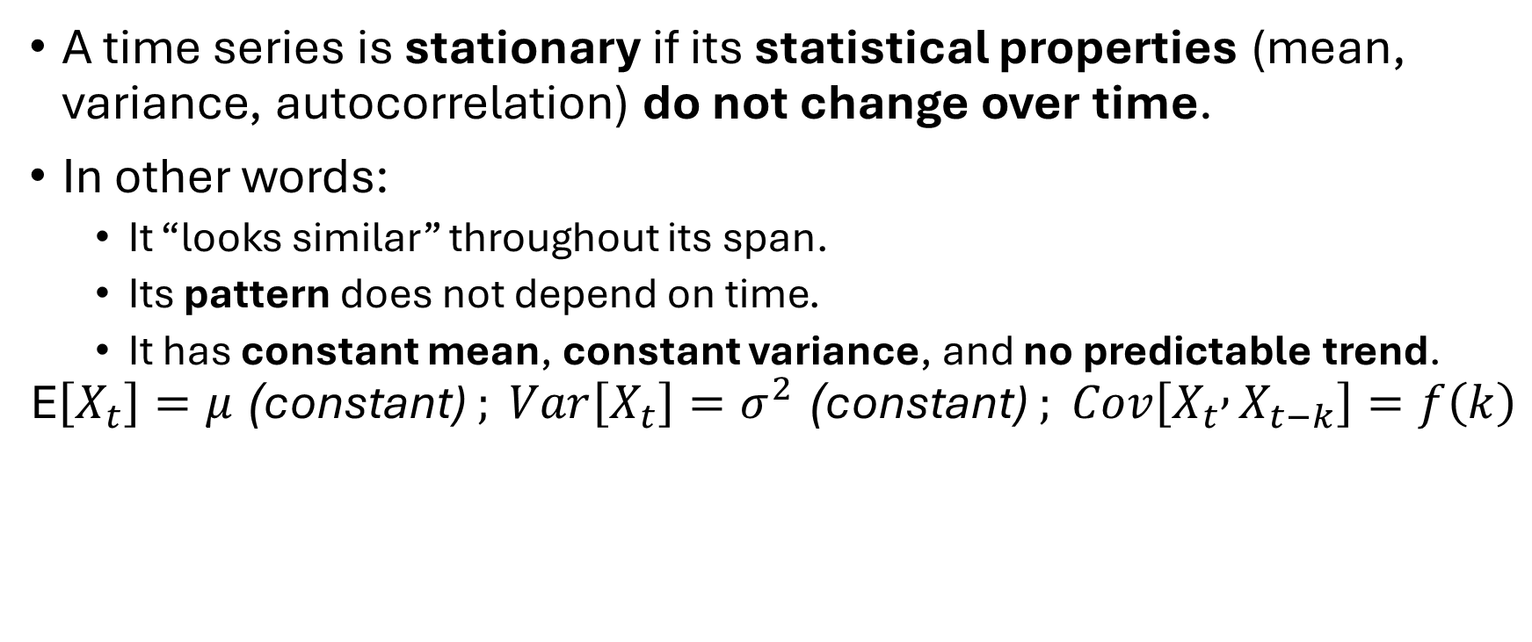
1. What is a Stationary Time Series?
A time series is stationary if its statistical properties (mean, variance, autocorrelation) do not change over time.
In other words:
It “looks similar” throughout its span.
Its pattern does not depend on time.
It has constant mean, constant variance, and no predictable trend.
$$\text{E}\left[X_{t}\right]=μ\text{ (}\text{constant}\text{)} ; Var\left[X_{t}\right]=σ^{2}\text{ (}\text{constant}\text{)} ; Cov\left[X_{t} , X_{t−k}\right]=f\left(k\right)$$

Slide 152
2. Why Stationarity Matters
Most statistical methods (correlation, regression, ARIMA models, hypothesis testing) assume stationarity.
If the data is non-stationary, it may:
Show spurious relationships.
Mislead statistical inferences.
Require transformation (e.g., differencing or detrending).

Slide 153
3. Types of Non-Stationarity
Type | Description | Example
Trend Stationarity | Mean changes over time (upward/downward trend) | GDP growth
Seasonal Stationarity | Variance or mean changes periodically | Monthly sales
Random Walk | No mean reversion; variance increases with time | Stock prices

Slide 154
Dataset
We’ll use the same monthly sales dataset from Lessons 1–5 to test for stationarity.

Slide 155
# Generate synthetic monthly sales data
date_rng = pd.date_range(
start='2015-01-01', end='2023-12-31', freq='M’)
np.random.seed(42)
trend = np.linspace(100, 300, len(date_rng))
seasonality =
20 * np.sin(2 * np.pi * date_rng.month / 12)
noise = np.random.normal(0, 8, len(date_rng))
sales = trend + seasonality + noise

Slide 156
df = pd.DataFrame(
{'Date': date_rng, 'Sales': sales}
)
df.set_index('Date', inplace=True)

Slide 157
Step 1: Visual Inspection for Stationarity
Let’s plot the data to see if mean or variance changes over time.

Slide 158
sns.lineplot(x=df.index, y='Sales', data=df)

Slide 159
Observation
You’ll notice an upward trend — clear evidence of non-stationarity because the mean increases over time.

Slide 160
Step 2: Check Rolling Mean and Variance
Compute rolling statistics to visualize whether mean and variance are constant.

Slide 161
roll_mean = df['Sales'].rolling(window=12).mean()
roll_std = df['Sales'].rolling(window=12).std()
plt.plot(df['Sales'], label='Original', color='blue’)
plt.plot(roll_mean, label='Rolling Mean (12-month)', color='red’)
plt.plot(roll_std, label='Rolling Std Dev (12-month)', color='green')

Slide 162
Interpretation
The rolling mean (red line) changes significantly — non-stationary mean.
The rolling std (green line) increases over time — non-stationary variance.
Thus, the data is likely non-stationary.

Slide 163
Step 3: Perform Augmented Dickey–Fuller (ADF) Test
The ADF test checks statistically whether a series is stationary.

Slide 164
from statsmodels.tsa.stattools import adfuller
result = adfuller(df['Sales'])
print('ADF Statistic:', result[0])
print('p-value:', result[1])
for key, value in result[4].items():
print(f'Critical Value ({key}): {value}')

Slide 165
Interpretation
Term | Meaning
ADF Statistic | More negative = stronger evidence of stationarity
p-value | If p < 0.05 → Stationary; else → Non-stationary
Critical Values | Thresholds for confidence levels (1%, 5%, 10%)

Slide 166
If the p-value > 0.05, we fail to reject the null hypothesis — the data is non-stationary.

Slide 167
Step 4: Making the Series Stationary
To transform the series into a stationary one, we can remove the trend or difference the data (covered in Lesson 7). But for now, let’s visually detrend to see the effect.

Slide 168
Detrending using Rolling Mean
detrended = df['Sales'] - df['Sales'].rolling(window=12).mean()
sns.lineplot(x=detrended.index, y=detrended)

Slide 169
Now, the mean should look roughly constant, though some variance may remain.

Slide 170
Recheck with ADF:
result_detrended = adfuller(detrended.dropna())
print('ADF Statistic (Detrended):', result_detrended[0])
print('p-value (Detrended):', result_detrended[1])

Slide 171
If p-value < 0.05 → The detrended series is now stationary.

Slide 172
Step 5: Log Transformation (Variance Stabilization)
When the variance grows with time, a log transform often helps stabilize it.

Slide 173
df['Log_Sales'] = np.log(df['Sales'])
sns.lineplot(x=df.index, y='Log_Sales', data=df)
plt.show()
# Re-run ADF test
result_log = adfuller(df['Log_Sales'])
print('ADF Statistic (Log Transformed):', result_log[0])
print('p-value (Log Transformed):', result_log[1])

Slide 174
The log transform often reduces variance but does not remove the trend fully — differencing may still be needed.

Slide 175
Step 6: Summary of Stationarity Tests
Test / Method | Checks | Interpretation
Visual Plot | Changing trend/variance | First quick inspection
Rolling Mean/Std | Moving averages | Constant = stationary
ADF Test (p-value) | Mean reversion | p < 0.05 → stationary
Log Transform | Reduces variance | Use before differencing
Differencing | Removes trend | Makes series stationary (next lesson)

Slide 176

Best Practices
Visualize
Always visualize first, then use ADF or KPSS test to confirm.
Be
Trend or seasonality must be removed before modeling.
Apply
Apply log, sqrt, or Box–Cox transform for heteroscedasticity.
Test
For business data, test both raw and smoothed versions to interpret patterns correctly.

Slide 177
Common Pitfalls
Misinterpreting ADF: A p-value above 0.05 doesn’t mean the data is bad; it just needs transformation.
Short time series: ADF test may fail if too few data points (< 50).
Ignoring seasonality: Detrending alone may not remove seasonal non-stationarity.
Not removing NaNs: Always drop missing values before ADF.

Slide 178
Differencing Time Series Data
Lesson 7

Slide 179
Objective
To understand what differencing is, why it’s used to achieve stationarity, and how to apply it effectively in pandas to remove trends and seasonality — preparing a time series for deeper statistical or forecasting analysis.

Slide 180
Conceptual Explanation

Slide 181
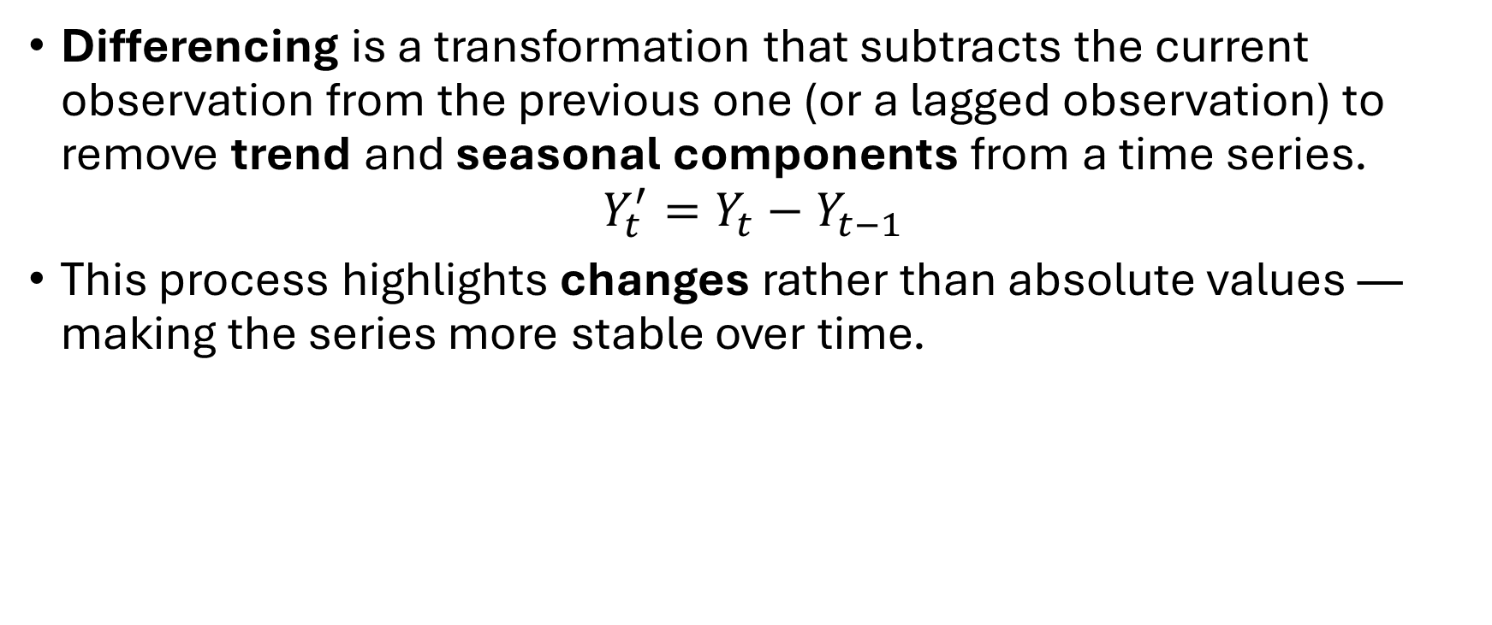
1. What is Differencing?
Differencing is a transformation that subtracts the current observation from the previous one (or a lagged observation) to remove trend and seasonal components from a time series.
$$Y_{t}^{′}=Y_{t}−Y_{t−1}$$
This process highlights changes rather than absolute values — making the series more stable over time.

Slide 182
2. Why Differencing Works
Time | Sales | First Difference
Jan | 100 | –
Feb | 105 | 5
Mar | 110 | 5
Apr | 120 | 10
Non-stationary data often has a trend or growth component.
By differencing consecutive observations, the trend is neutralized, leaving behind a series with a constant mean and variance.
Example:
The differences (5, 5, 10) show the rate of change rather than the raw trend.

Slide 183
3. Types of Differencing
Type | Formula | Purpose
First-order differencing | (Y't = Y_t - Y{t-1}) | Removes linear trends
Second-order differencing | (Y''_t = Y't - Y'{t-1}) | Removes residual trends left after first differencing
Seasonal differencing | (Y't = Y_t - Y{t-s}) | Removes seasonal effects (e.g., s = 12 for monthly data)

Slide 184
Dataset
We’ll use the same monthly sales dataset with trend and seasonality (2015–2023).

Slide 185
# Generate synthetic time series
date_rng = pd.date_range(start='2015-01-01’,
end='2023-12-31', freq='M')
np.random.seed(42)
trend = np.linspace(100, 300, len(date_rng))
seasonality = 20 * np.sin(2 * np.pi *
date_rng.month / 12)
noise = np.random.normal(0, 8, len(date_rng))
sales = trend + seasonality + noise

Slide 186
df = pd.DataFrame(
{'Date': date_rng, 'Sales': sales}
)
df.set_index('Date', inplace=True)

Slide 187
Step 1: Visualize the Original Series
sns.lineplot(x=df.index, y='Sales', data=df)

Slide 188
Observation
Upward trend + repeating cycles → Non-stationary.

Slide 189
Step 2: Apply First-Order Differencing
Let’s remove the trend component.

Slide 190
df['FirstDiff'] = df['Sales'].diff()
sns.lineplot(
x=df.index, y='FirstDiff', data=df,
color='red')
plt.show()

Slide 191
Interpretation
The trend has disappeared.
The series now oscillates around zero — closer to stationary.
The mean and variance look more constant.

Slide 192
Step 3: Check Stationarity After Differencing
We’ll verify using the Augmented Dickey–Fuller (ADF) test.

Slide 193
from statsmodels.tsa.stattools import adfuller
result = adfuller(df['FirstDiff'].dropna())
print('ADF Statistic:', result[0])
print('p-value:', result[1])

Slide 194
Interpretation
If p-value < 0.05, the differenced series is stationary.
You’ve successfully removed the trend component.

Slide 195
Step 4: Compare Before and After Differencing
fig, axes = plt.subplots(2, 1, figsize=(12,8), sharex=True)
sns.lineplot(x=df.index, y='Sales', data=df,
ax=axes[0], color='blue')
axes[0].set_title('Original Series (Non-Stationary)')
sns.lineplot(x=df.index, y='FirstDiff', data=df,
ax=axes[1], color='red')
axes[1].set_title('First Differenced Series (Stationary)')
plt.show()

Slide 196
Visual Takeaway
The top plot drifts upward — non-stationary.
The bottom plot fluctuates around zero — approximately stationary.

Slide 197
Step 5: Seasonal Differencing
If the data has a seasonal component (e.g., monthly pattern repeating yearly), use seasonal differencing with a lag equal to the seasonal period (s=12).

Slide 198
df['SeasonalDiff'] = df['Sales'].diff(12)
sns.lineplot(x=df.index, y='SeasonalDiff’,
data=df, color='green')
plt.show()

Slide 199
Interpretation
Removes annual cycles but may still retain trend.
Ideal for strongly seasonal data (like monthly or quarterly business data).

Slide 200
Step 6: Double (Second-Order) Differencing
Sometimes, after first differencing, a residual trend remains.
In that case, difference again.

Slide 201
df['SecondDiff'] = df['FirstDiff'].diff()
sns.lineplot(x=df.index, y='SecondDiff’,
data=df, color='purple')
plt.show()

Slide 202
Then test stationarity again using ADF:
result2 = adfuller(df['SecondDiff'].dropna())
print('ADF Statistic (2nd Diff):', result2[0])
print('p-value (2nd Diff):', result2[1])
If p-value < 0.05, the second difference is stationary — trend and residual drift fully removed.

Slide 203
Choosing the Right Differencing Method
Pattern | Method | Lag (k)
Simple upward/downward trend | First-order differencing | k = 1
Seasonal cycle | Seasonal differencing | k = s (e.g., 12 for months)
Both trend + seasonality | Seasonal + first-order | k = 1 and s
Remaining drift after differencing | Second-order differencing | k = 2

Slide 204
Best Practices
Visualize before differencing — know what component you’re removing.
Check stationarity after differencing using ADF.
Avoid over-differencing — it can introduce unnecessary noise.
Combine log transform + differencing for data with growing variance.
Use df.diff(periods=s) to remove seasonal effects directly.

Slide 205
Common Pitfalls
Mistake | Consequence
Over-differencing | Turns stationary data into noise
Differencing without lag understanding | Removes meaningful information
Forgetting to drop NaN after differencing | Errors in plotting/statistical tests
Not testing stationarity after | False assumption of success

Slide 206
Using Correlation Plots to Visualize Time Series Data
Lesson 8

Slide 207
Objective
To learn how to visualize and interpret correlations in time series data using autocorrelation plots (ACF), partial autocorrelation plots (PACF), and correlation heatmaps — all without using machine learning models.

Slide 208
Conceptual Explanation

Slide 209
1. What is Correlation in Time Series?
Correlation measures how one variable changes with respect to another.
In time series, we are often interested in how a variable correlates with its own past values (lagged versions).

Slide 210
2. Key Concepts
Term | Description | Example
Autocorrelation | Correlation of a series with its past (lagged) values | "How similar are sales this month and last month?"
Lag | The time shift between observations | Lag = 1 means one period back
Partial Autocorrelation | Correlation of a series with its lag, removing effects of intermediate lags | Isolates “direct” lag relationships

Slide 211
3. Why It’s Important
Detects seasonal periodicity or time delay patterns.
Helps determine lag lengths for statistical modeling (e.g., AR terms in ARIMA).
Identifies memory in the data — how far back the data “remembers” its past.

Slide 212
Dataset
We’ll again use the same monthly sales dataset from Lessons 1–7, with clear trend, seasonality, and noise.

Slide 213
# Generate synthetic dataset
date_rng = pd.date_range(start='2015-01-01', end='2023-12-31', freq='M')
np.random.seed(42)
trend = np.linspace(100, 300, len(date_rng))
seasonality = 20 * np.sin(2 * np.pi * date_rng.month / 12)
noise = np.random.normal(0, 8, len(date_rng))
sales = trend + seasonality + noise
df = pd.DataFrame({'Date': date_rng, 'Sales': sales})
df.set_index('Date', inplace=True)

Slide 214
Step 1: Visual Inspection
sns.lineplot(x=df.index, y='Sales', data=df)
plt.show()

Slide 215
Observation
The upward trend and seasonal wave imply that autocorrelation is expected — the present is related to the recent past.

Slide 216
Step 2: Autocorrelation Function (ACF) Plot
The autocorrelation plot shows correlation coefficients between a series and its lagged versions.

Slide 217
from statsmodels.graphics.tsaplots import plot_acf
plot_acf(df['Sales'], lags=24)
plt.show()

Slide 218
Interpretation
Each bar represents correlation with a specific lag.
Lag 1: Correlation with the previous month.
Lag 12: Annual seasonality — if correlation spikes there, it indicates yearly cycles.
Slowly decaying correlations → non-stationarity or strong trend.

Slide 219
Step 3: Partial Autocorrelation Function (PACF) Plot
PACF shows direct correlation with lag k, removing effects of shorter lags.

Slide 220
from statsmodels.graphics.tsaplots import plot_pacf
plot_pacf(df['Sales'], lags=24, method='ywm')
plt.show()

Slide 221
Interpretation
PACF helps identify direct dependencies.
A significant spike at lag 1 → the current value depends strongly on the previous month.
Sharp cutoff after a few lags → suggests short-term memory.

Slide 222
Step 4: ACF and PACF on Differenced Series
To focus on correlations after removing trend, let’s difference the data (Lesson 7).

Slide 223
df['FirstDiff'] = df['Sales'].diff().dropna()
fig, axes = plt.subplots(1, 2, figsize=(14,5))
plot_acf(df['FirstDiff'].dropna(),
lags=24, ax=axes[0])
plot_pacf(df['FirstDiff'].dropna(), lags=24, method='ywm', ax=axes[1])

Slide 224
Interpretation
The differenced series should show weaker autocorrelations (less persistence).
Seasonal spikes (e.g., lag 12) remain if seasonality is strong.

Slide 225
Step 5: Lag Plot (pandas built-in)
A lag plot shows scatter between a series and its lagged version — used to visually check autocorrelation.

Slide 226
from pandas.plotting import lag_plot
plt.figure(figsize=(5,5))
lag_plot(df['Sales'])
plt.show()

Slide 227
Interpretation
A clear linear pattern → high correlation (series depends on its past).
Random scatter → low correlation (stationary or noisy).

Slide 228
from pandas.plotting import lag_plot
plt.figure(figsize=(5,5))
lag_plot(df['Sales'], lag=12)
plt.show()
You can also explore different lags:
A visible pattern at lag 12 confirms annual seasonality.

Slide 229
Step 6: Correlation Heatmap Between Multiple Lags
Let’s create a heatmap to visualize autocorrelation over multiple lags.

Slide 230
# Create lagged columns
lags = 12
lag_df = pd.concat([df['Sales'].shift(i) for i in range(lags + 1)], axis=1)
lag_df.columns = ['t'] + [f't-{i}' for i in range(1, lags + 1)]
# Compute correlation matrix
corr_matrix = lag_df.corr()
sns.heatmap(corr_matrix, annot=True, fmt=".2f", cmap='coolwarm', cbar=True)
plt.show()

Slide 231
Interpretation
High correlations near diagonal → strong short-term memory.
Darker patches at lag 12 → seasonal dependence.
A rapid fade in color → stationary process with low long-term memory.

Slide 232
Step 7: Cross-Correlation (for Two Time Series)
If you have multiple related time series (e.g., Sales and Advertising), you can check how one leads or lags the other.

Slide 233
# Create a second variable (Advertising) correlated with Sales
df['Advertising'] = df['Sales'].shift(1) + np.random.normal(0, 10, len(df))
# Cross-correlation plot
from statsmodels.tsa.stattools import ccf
corr_vals = ccf(df['Advertising'].dropna(), df['Sales'].dropna())[:12]
plt.bar(range(len(corr_vals)), corr_vals)
plt.show()

Slide 234
Interpretation
Peak at lag 1 means advertising precedes changes in sales by one period (a lead-lag relationship).

Slide 235
Summary of Correlation Tools
Plot Type | Purpose | Library
ACF | Shows overall autocorrelation structure | statsmodels
PACF | Shows direct correlations | statsmodels
Lag Plot | Visual pattern of correlation | pandas.plotting
Heatmap | Correlation matrix between multiple lags | seaborn
Cross-Correlation | Relationship between two time series | statsmodels

Slide 236
Best Practices
Always difference or detrend before interpreting ACF/PACF.
Limit lags based on your data’s frequency (e.g., 12 for monthly).
Watch for seasonal spikes — they confirm periodicity.
Use correlation heatmaps for intuitive multi-lag patterns.
For multivariate time series, explore cross-correlations to find leading indicators.

Slide 237
Common Pitfalls
Mistake | Consequence
Using ACF on non-stationary data | Artificially high correlations
Misreading seasonal lags | Confusing cycles with trends
Over-interpreting noise | Seeing structure where none exists
Not standardizing time scales | Wrong lag interpretation

Slide 238
Time Series EDA (Without ML Models)
Lesson | Concept | Key Takeaway
1 | Line & Box Plots | Visualize trends & seasonality
2 | Spotting Patterns | Identify trend, seasonal, irregular components
3 | Decomposition | Separate series into T + S + R
4 | Moving Average | Smooth short-term noise
5 | Exponential Smoothing | Weighted smoothing for responsiveness
6 | Stationarity Checks | Ensure constant mean/variance
7 | Differencing | Remove trends for stationarity
8 | Correlation Plots | Detect dependencies & periodicity

